Slide 1
Context
Hotel Rating Classification
Business Problem Understanding
Business Objective
EDA Visualization
Model Building
Model Deployment

Slide 2
Business problem understanding
The classifications are: Tourist (★) | Standard (★★) | Comfort (★★★) | First Class (★★★★) | Luxury (★★★★★)
From the initial purpose of informing travellers on basic facilities that can be expected, the objectives of hotel rating have expanded into a focus on the hotel experience as a whole.

Slide 3
Business objective
To understand the dataset and what the customers are looking online when booking a hotel
Hotel ratings are often used to classify hotels according to their quality.

Slide 4
EDA Visualization

Slide 5
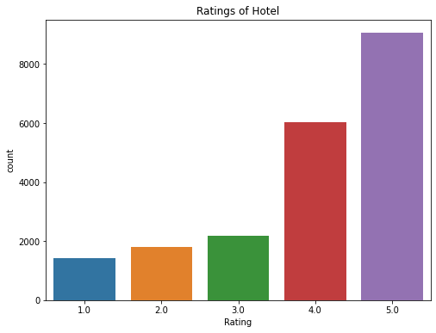
Ratings of Hotel
The hotel is working efficiently on its own.
More than half of the customers had given a positive feedback.
We will try to figure out the problems with 1,2,3 star ratings.

Slide 6
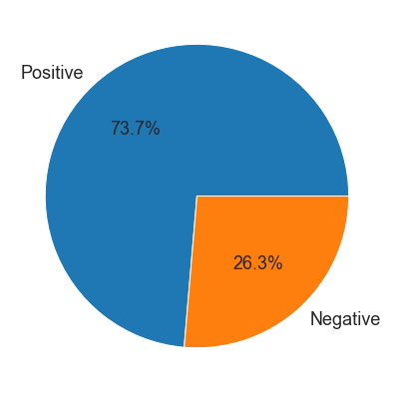
REVIEWS
The rating between1-3 are considered as negative ratings which comprises of around 26.3% as per the dataset given.
The rating 4&5 are considered as positive ratings which comprises of around 73.7% as per the dataset given.

Slide 7
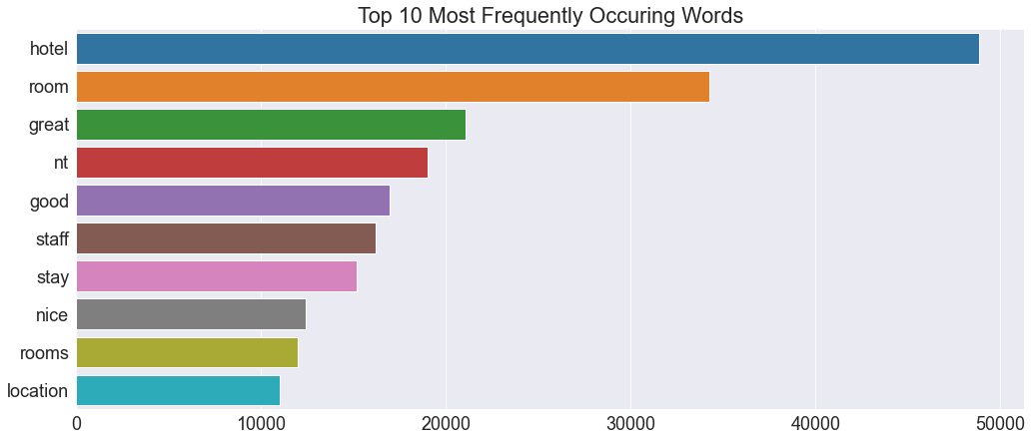
Frequently Occurring Phrases

Slide 8
Word Cloud
Word cloud for 1 star
Word cloud for 2 star
Word cloud for 3 star
Word cloud for 4 star
Word cloud for 5 star

Slide 9
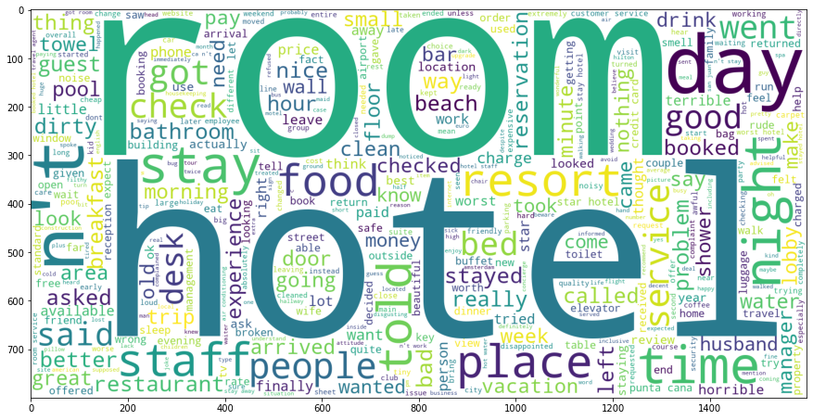
Word Cloud for 1 Star Rating
We see the people unsatisfied = rating 1 in this words the same rating 5 & 4 but plus room - hotel - place - staff - door - check in - sleep - toilet - resort -water.

Slide 10
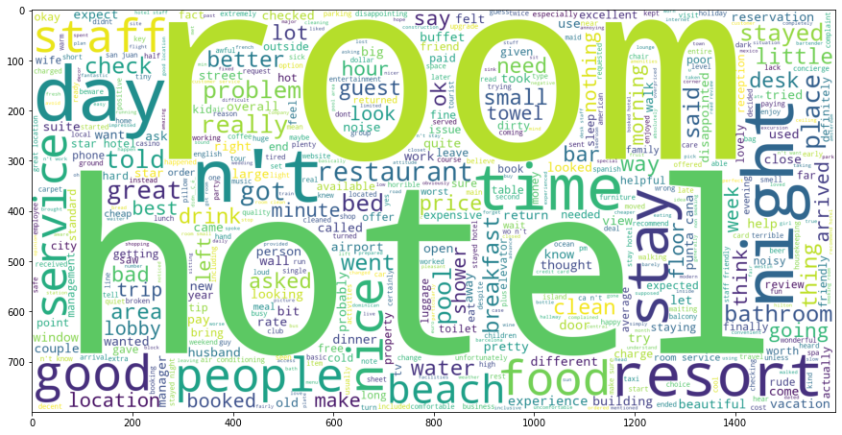
Word cloud for 2 Star Rating
We see the people unsatisfied = rating 2 in this words the same rating 5 & 4 but plus Hotel - staff - beach - service - disk - stay - shower

Slide 11
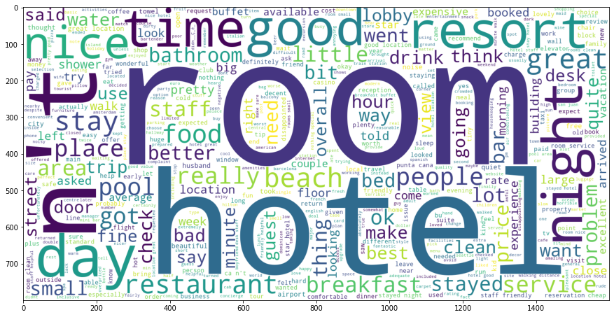
Word Cloud for 3 Star Rating

Slide 12
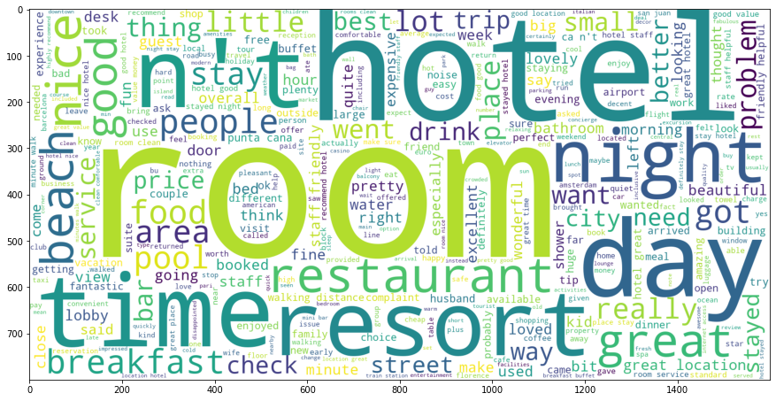
Word Cloud for 4 Star Rating
We see the people satisfy = rating 4 in this words the same rating 5 but plus ... beautiful hotel - staff friendly - service - street.

Slide 13
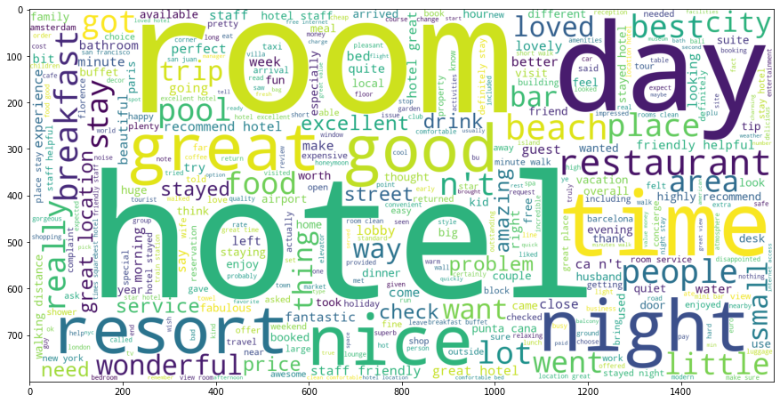
Word Cloud for 5 Star Rating
We see the people satisfy = rating 5 in this words In general the hotel - room - night - beach - restaurant and food and drink - bed - pool - locations.

Slide 14
Model Building
Model | Accuracy
Logistic Regression | 92.23111458130002%
XGBoost | 90.02537575639273%
Light GBM | 92.5434315830568%
MLP Classifier | 92.5629513956666%
Random Forest | 89.42026156548897%

Slide 15
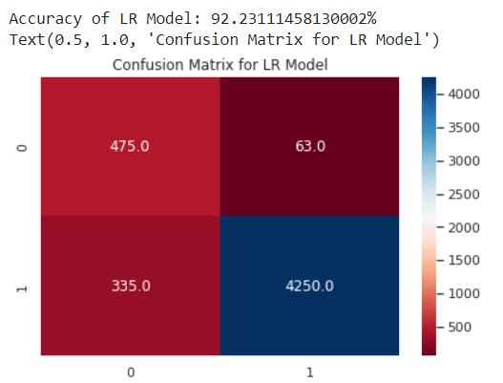
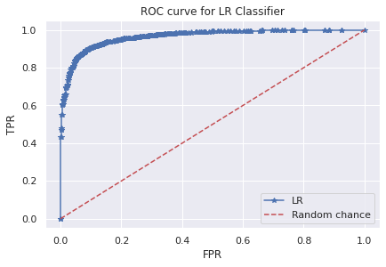
Logistic Regression
The model tells us o is negative and 1 is positive and the accuracy of this model is 92%.
We won't be able to figure out which review is neutral.

Slide 16
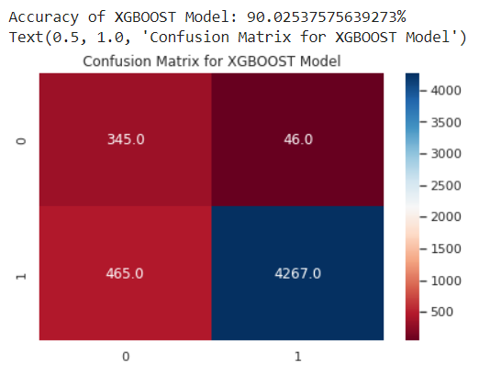
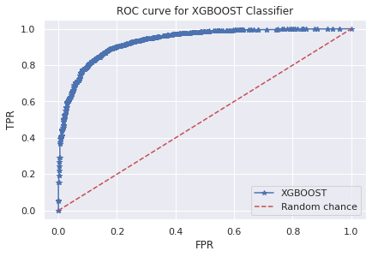
XGBoost
Gradient Boosting model is very sensitive to outliers since every classifier is forced to fix the errors in the predecessor learners.
The accuracy of the model is 90%

Slide 17
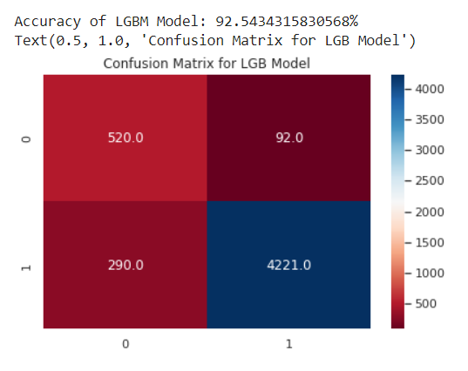
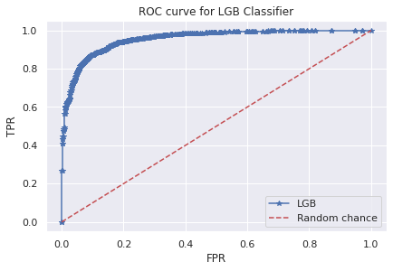
Light GBM
We choose this model for deployment, because the accuracy of this model is 92.5%.
Light GBM is significantly faster than XGBoost but delivers almost equivalent performance.

Slide 18
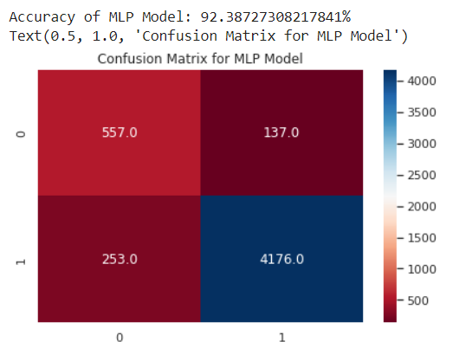
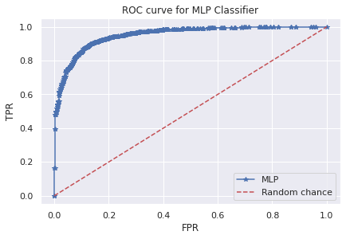
MLP Classifier
MLP Classifier relies on an underlying Neural Network to perform the task of classification
Disadvantages of MLP include too many parameters because it is fully connected.

Slide 19
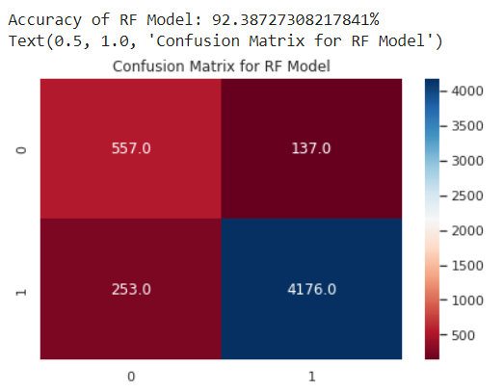
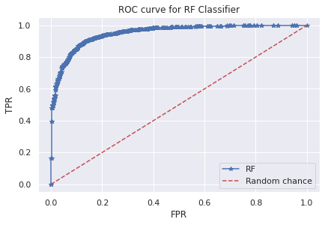
Random Forest
A random forest is an ensemble classifier that estimates based on the combination of different decision tree.
Random forests are found to be biased while dealing with categorical variables trees

Slide 20
Model Deployment

Slide 21
Streamlit
We are using Streamlit to deploy the model
Using pickle we dump the model in a pkl file
We created the architecture of the web Application using Streamlit methods
We initialized a variable ‘review’ where the user will give the text values
We load the same model using it’s pickle file
We feed the text value to the model and print the prediction

Slide 22
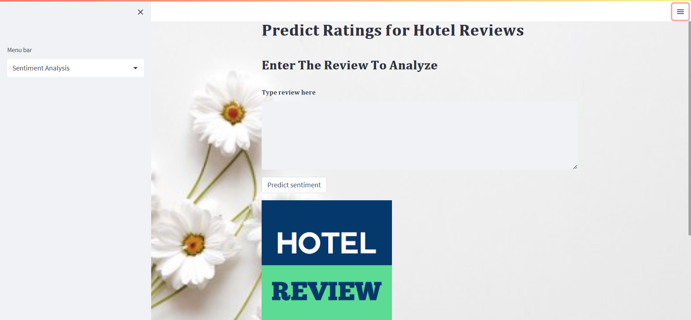
Web Interface
This is the web interface for hotel review system.
Here we can do sentimental analysis
we can find out keywords which are crucial to improve our services.

Slide 23
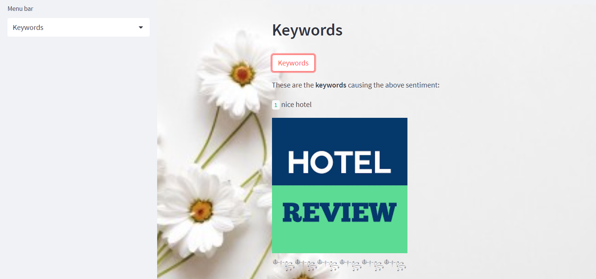
Keywords Web Interface
Type the review in the text box .
Press the keywords button it will show you the keywords results in the review.
We can use this keywords to tell the hotel manager where he should focus more.

